Slide 1
Heart Disease Predictor
By V Hari Ram Varma, E.Sai Praneeth Reddy

Slide 2

Introduction:-
Heart disease is a leading cause of mortality worldwide, making early detection and risk assessment essential for effective prevention and treatment. This project leverages machine learning to predict an individual's heart disease risk based on basic health metrics, including age, cholesterol levels, and other cardiovascular indicators.

Slide 3

Problem Statement:-
Heart disease is one of the leading causes of death worldwide; early detection is critical. To reduce this problem we have created a machine learning-based system that uses routine health metrics for risk assessment which helps healthcare providers make informed decisions and offers patients insights into modifiable risk factors.

Slide 4

Overview of Heart Disease and Its Impact:-
Strengths of Early Detection:- Early detection methods can significantly improve treatment outcomes and reduce mortality rates associated with heart disease.
Reduces Emergency Cases: Minimizes the need for costly emergency interventions by managing risks early.
Education: Informs patients about their risk levels and the importance of regular monitoring.
Quality of Life: Prevents severe complications, ensuring a healthier life for patients.

Slide 5
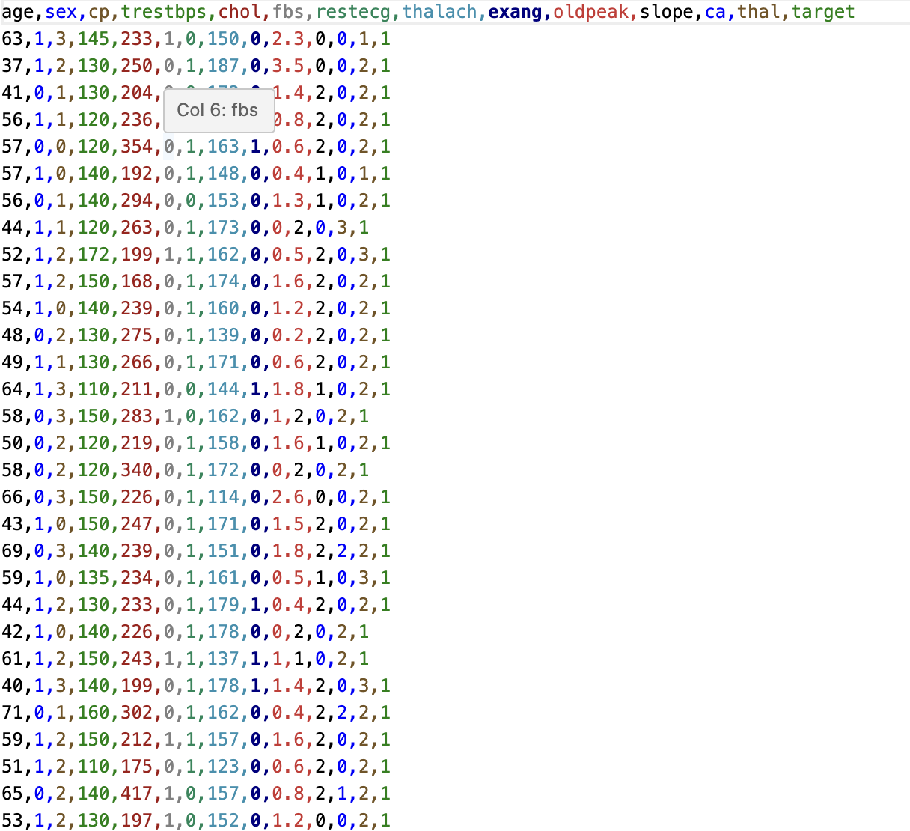
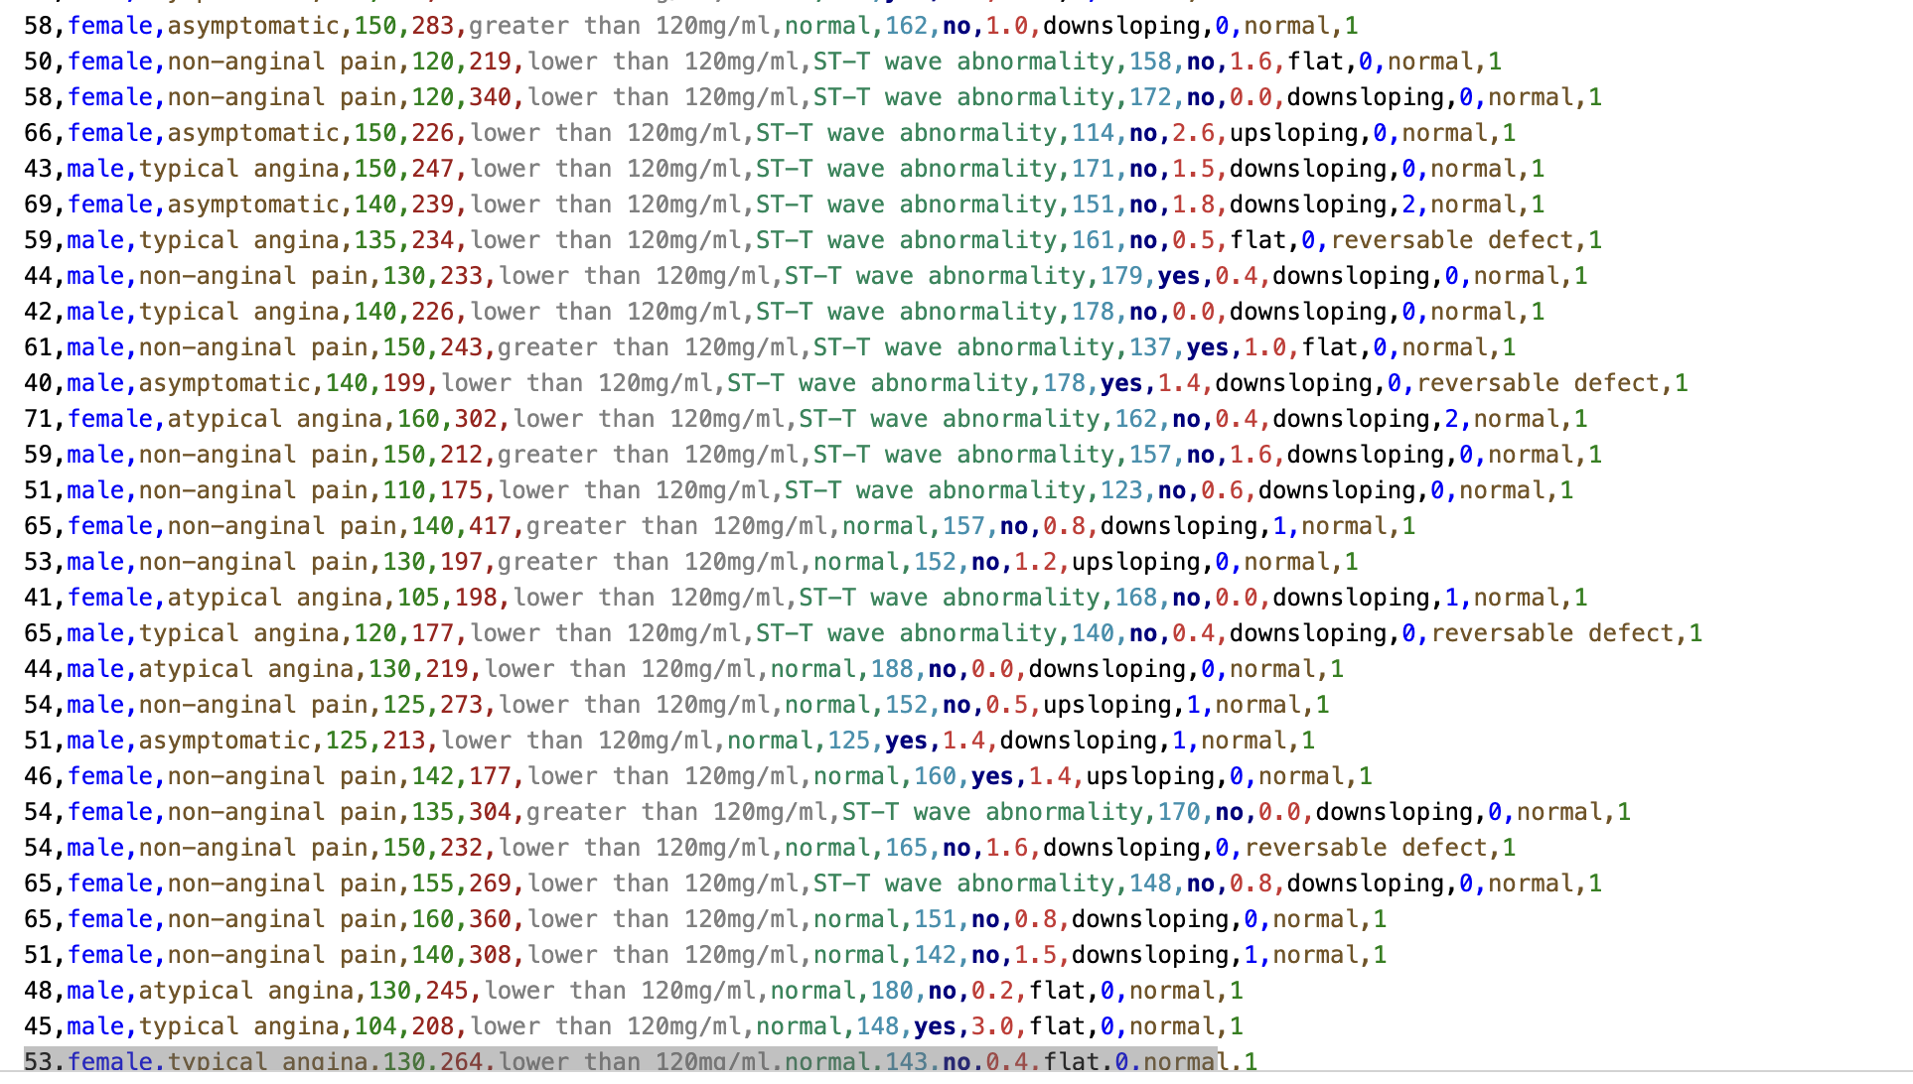
Dataset and Features:-
Original dataset
Data Collection: The dataset includes age, sex, chest pain type, blood pressure, cholesterol, and ECG readings.
Data Preprocessing: Categorical features are encoded, missing values addressed, and numeric features standardized. The dataset is split into training and test sets.
Modified dataset

Slide 6
Data Preprocessing:-
Categorical Encoding: Text features like sex and chest pain type are converted into numerical representations, making the data suitable for machine learning models.
Handling Missing Values: Missing values are addressed by filling with appropriate statistics (e.g., mean, median) or removing records, ensuring a complete dataset.
Normalization/Scaling: Standardization is applied to scale features consistently, enhancing model convergence and performance.
Data Split: The dataset is divided into training and test sets (e.g., 80/20 split) to evaluate model accuracy and prevent overfitting.

Slide 7

Model Selection:-
To select the most effective model, we tested a range of classifiers, including:
Logistic Regression
Linear Discriminant Analysis (LDA)
Quadratic Discriminant Analysis (QDA)
Random Forest
Decision Tree
AdaBoost
Gradient Boosting
Naive Bayes
Nu-SVC
Neural Network
Support Vector Machine (SVM)
Nearest Neighbours
These models were evaluated based on accuracy, precision, recall, and interpretability. Feature importance and Shapley values were then used to identify key risk factors for each prediction.
Based on the scores Logistic regression was identified as the best-performing model and was subsequently used in our predictor.

Slide 8
Evaluation Metrics:-
Metrics Used:
Accuracy: Overall correctness of the model.
Precision: Proportion of true positives among predicted positives.
Recall (Sensitivity): Proportion of actual positives identified by the model.
ROC-AUC Score: Measures model’s ability to distinguish between classes across thresholds.
Results Summary: Present key metrics (e.g., accuracy and AUC scores) for top models.

Slide 9
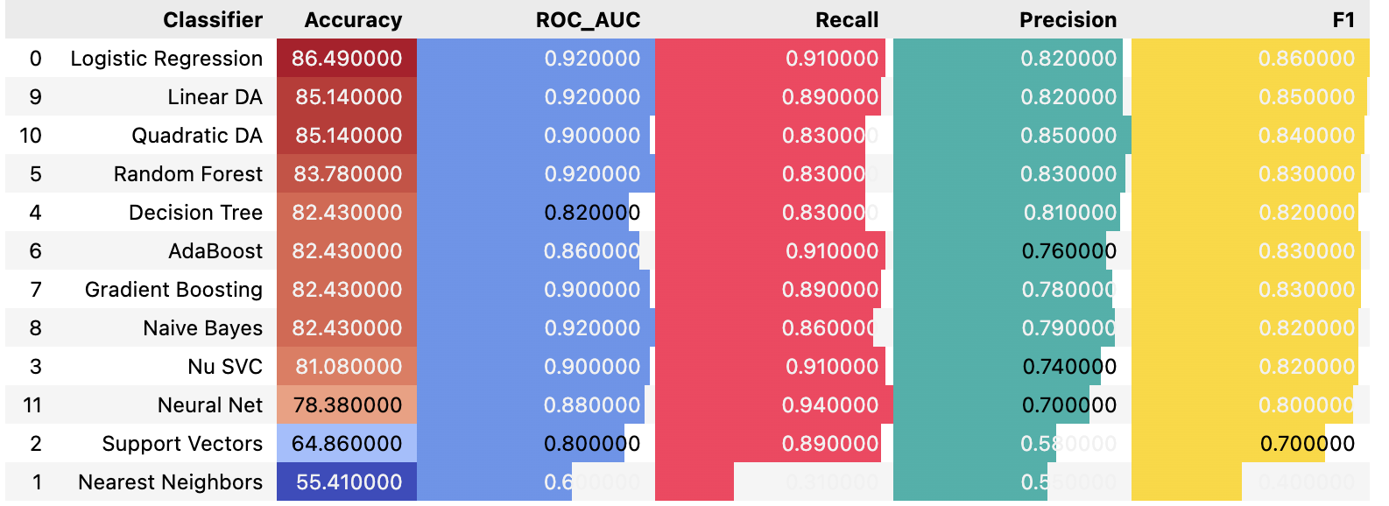
Experimental Results:-
Model Performance Metrics:
Logistic Regression: Accuracy = 86.49%, Precision = 0.92, Recall = 0.91, F1 Score = 0.82, ROC-AUC = 0.86
Linear DA: Accuracy = 85.14%, Precision = 0.92, Recall = 0.89, F1 Score = 0.82, ROC-AUC = 0.85
Quadratic DA: Accuracy = 85.14%, Precision = 0.90, Recall = 0.83, F1 Score = 0.85, ROC-AUC = 0.84
Additional models (Random Forest, AdaBoost, etc.) displayed varying metrics, all detailed to determine the most suitable model for high accuracy and interpretability.

Slide 10
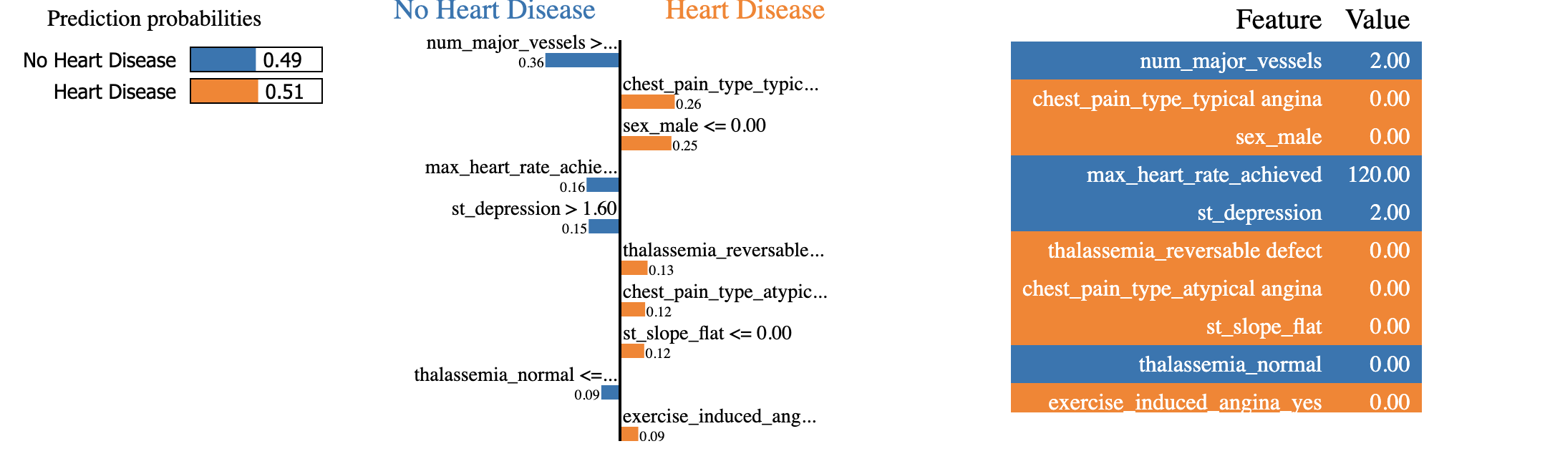
What’s Unique?
Key Feature: Identifies individual risk factors contributing to predictions (e.g., high cholesterol, high blood pressure).
Method Used: SHAP (SHapley Additive exPlanations) values to explain model predictions and visualize feature impact.
Benefit: Makes the model interpretable, providing actionable insights for healthcare providers.

Slide 11
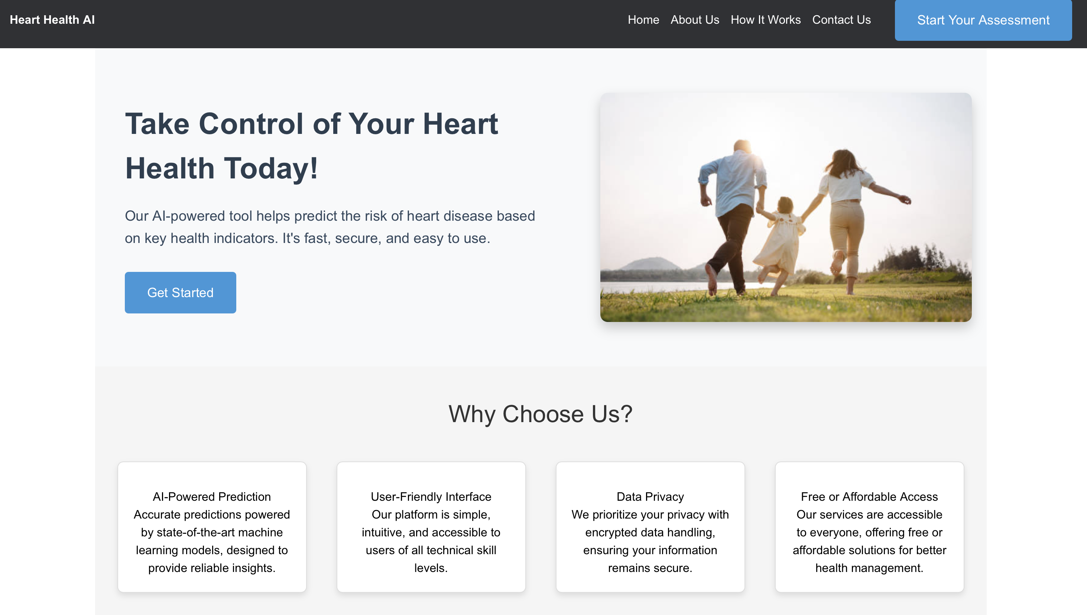
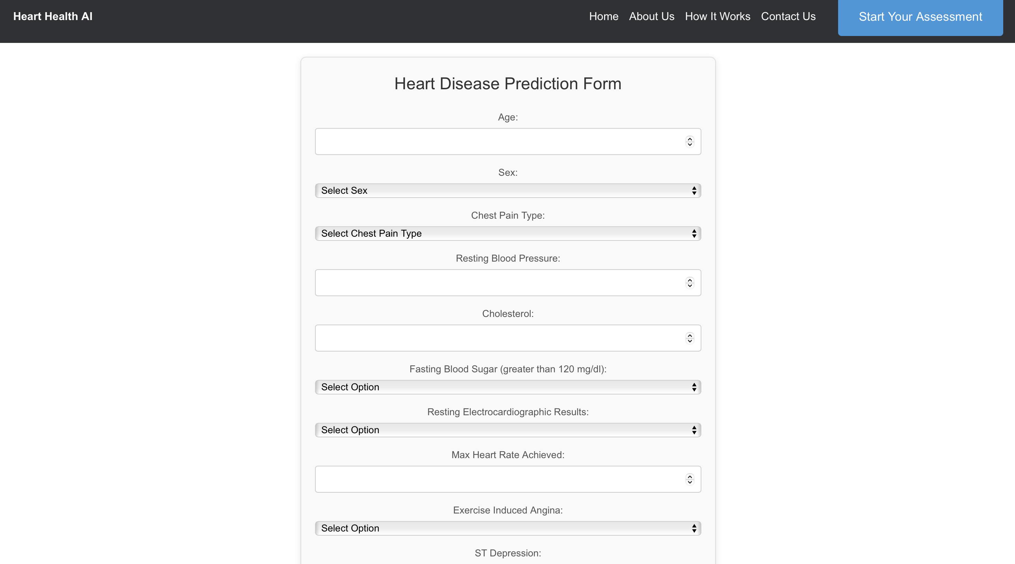

Slide 12

Conclusion:-
The heart disease prediction model effectively classifies individuals at risk, offering transparency by identifying specific risk factors. This interpretability feature equips healthcare providers with targeted information for better patient care.

Slide 13


Future Scope:-
In the future, we plan to expand the dataset to include more diverse groups, making the model more reliable for different populations. We also aim to explore deep learning to uncover complex patterns and improve accuracy.
Making the model available as a web or mobile app will make it easier for users to access. Adding real-time insights could help with quick health monitoring.
We also want to turn this project into a general disease predictor. By using data on daily habits like food intake, it could show risks for various diseases. It could also suggest lifestyle changes or treatments based on the risks identified, helping users improve their health.

Slide 14
Technologies used
Programming Languages: Python, HTML, CSS, JavaScript
Machine Learning Frameworks: Scikit-learn, XGBoost
Data Processing: Pandas, NumPy
Visualization: Matplotlib, Seaborn
Backend Framework: Flask
Frontend Development: HTML, CSS, JavaScript

Slide 15
GitHub Repository:-
https://github.com/harivegesna73/HeartdiseasePredictor

Slide 16


